Slide 1
Your First openFrameworks Application
CC Lab 2016 openFrameworks Week 2

Slide 2
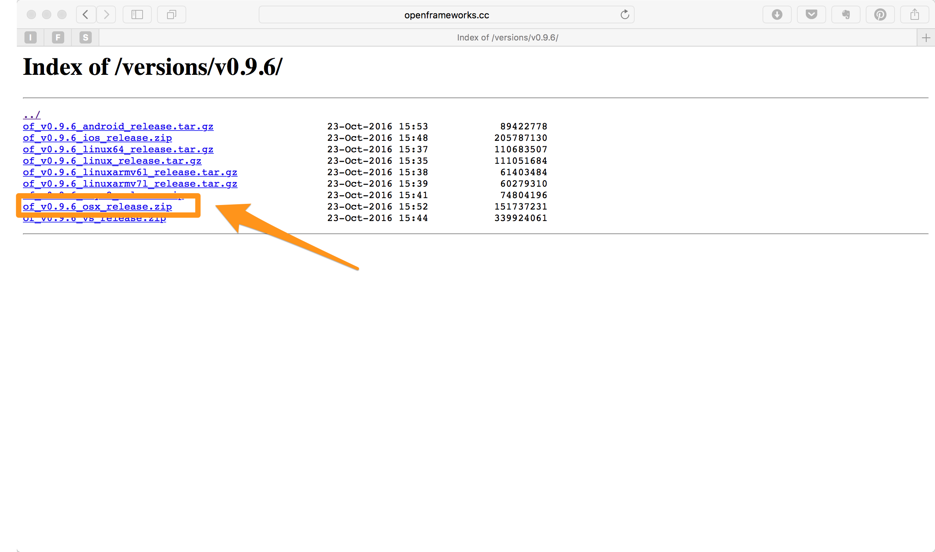
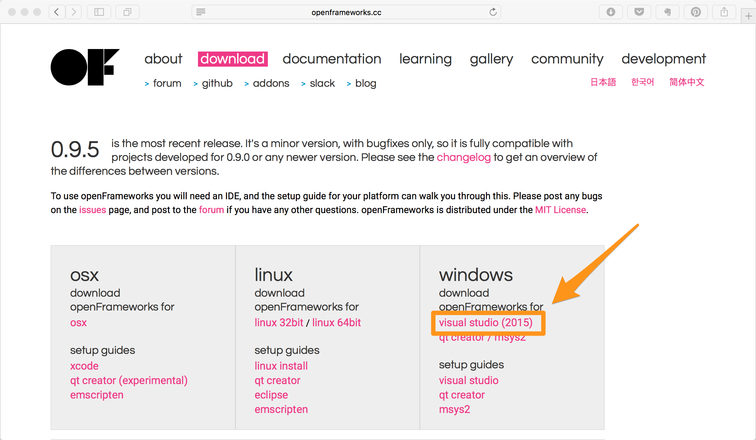
Mac
Download openFrameworks 0.9.6 from http://openframeworks.cc/versions/v0.9.6/
Windows
Download openFrameworks 0.9.5 from http://openframeworks.cc/download/
Notes:
For Mac, projectGenerator of 0.9.5 cannot generate new projects; projectGenerator of 0.9.6 and 0.9.4 works problematically. oF 0.9.3 or older won’t compile under macOS 10.12 and Xcode 8.

Slide 3
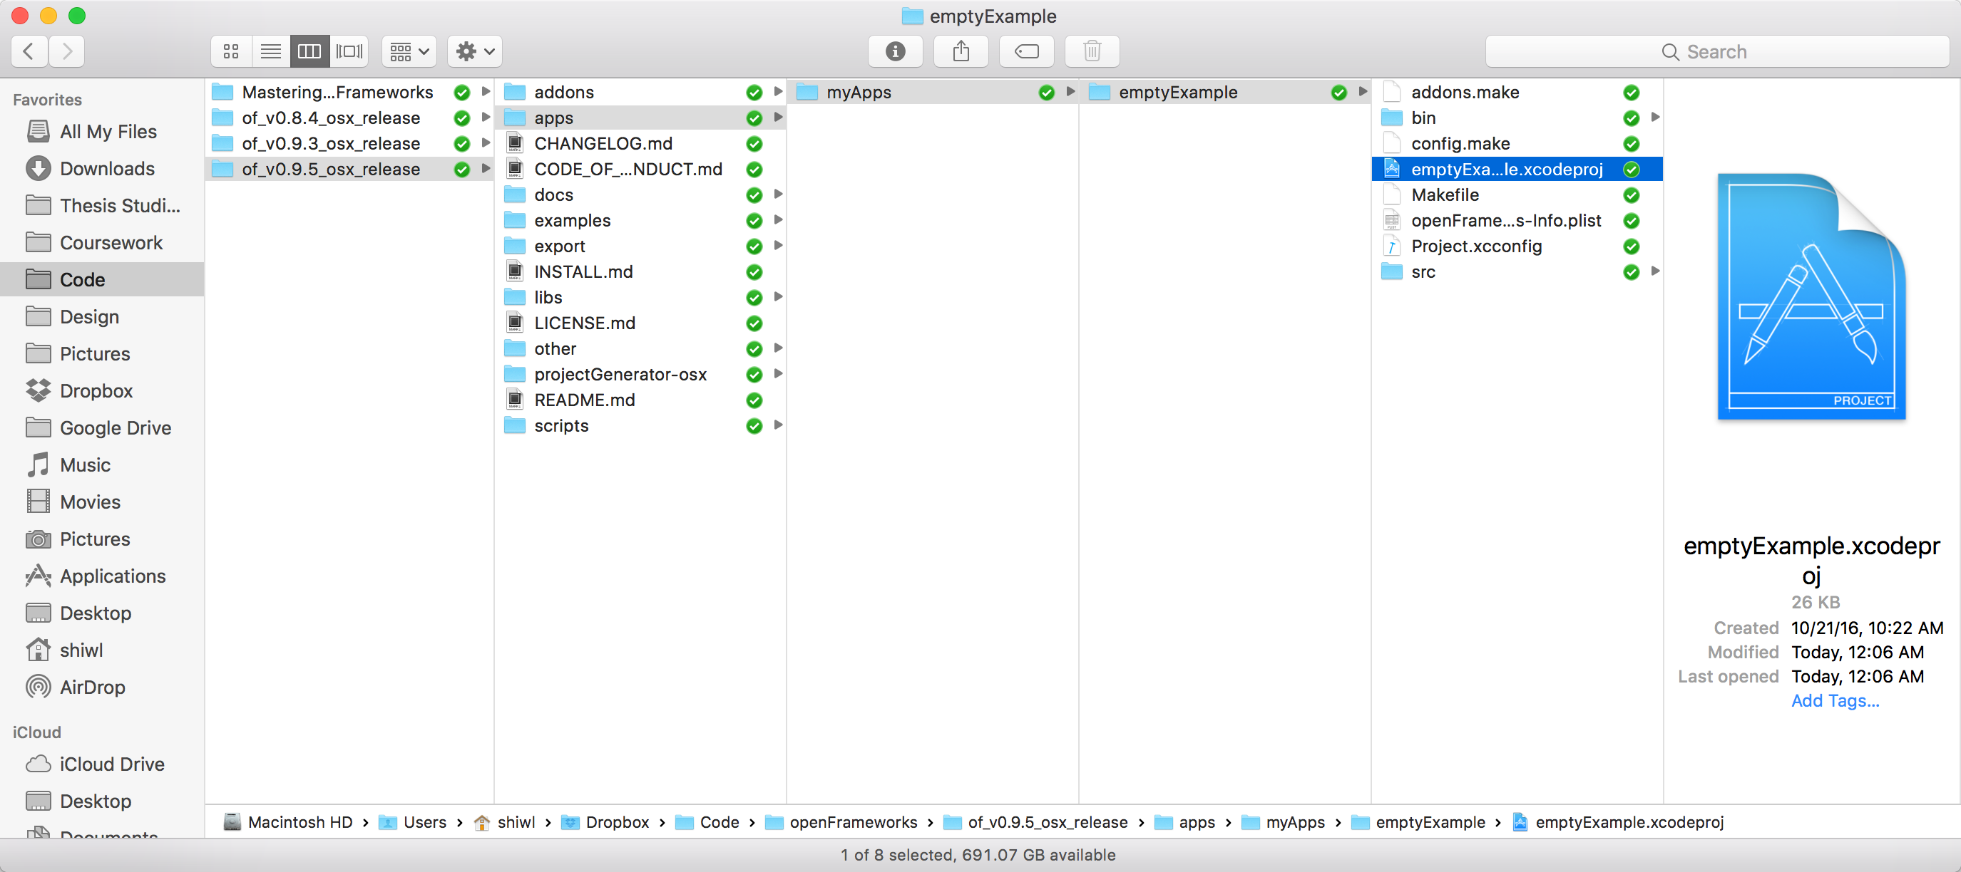
File structure of openFrameworks
Notes:
Important directories:
apps: your projects.
examples: example projects. Invaluable resources when you want to learn a function of oF by example.
addons: after downloading oF addons, put them here.
projectGenerator-osx(vs): a tool to help you generate new projects, or add/remove addons to/from them.

Slide 4
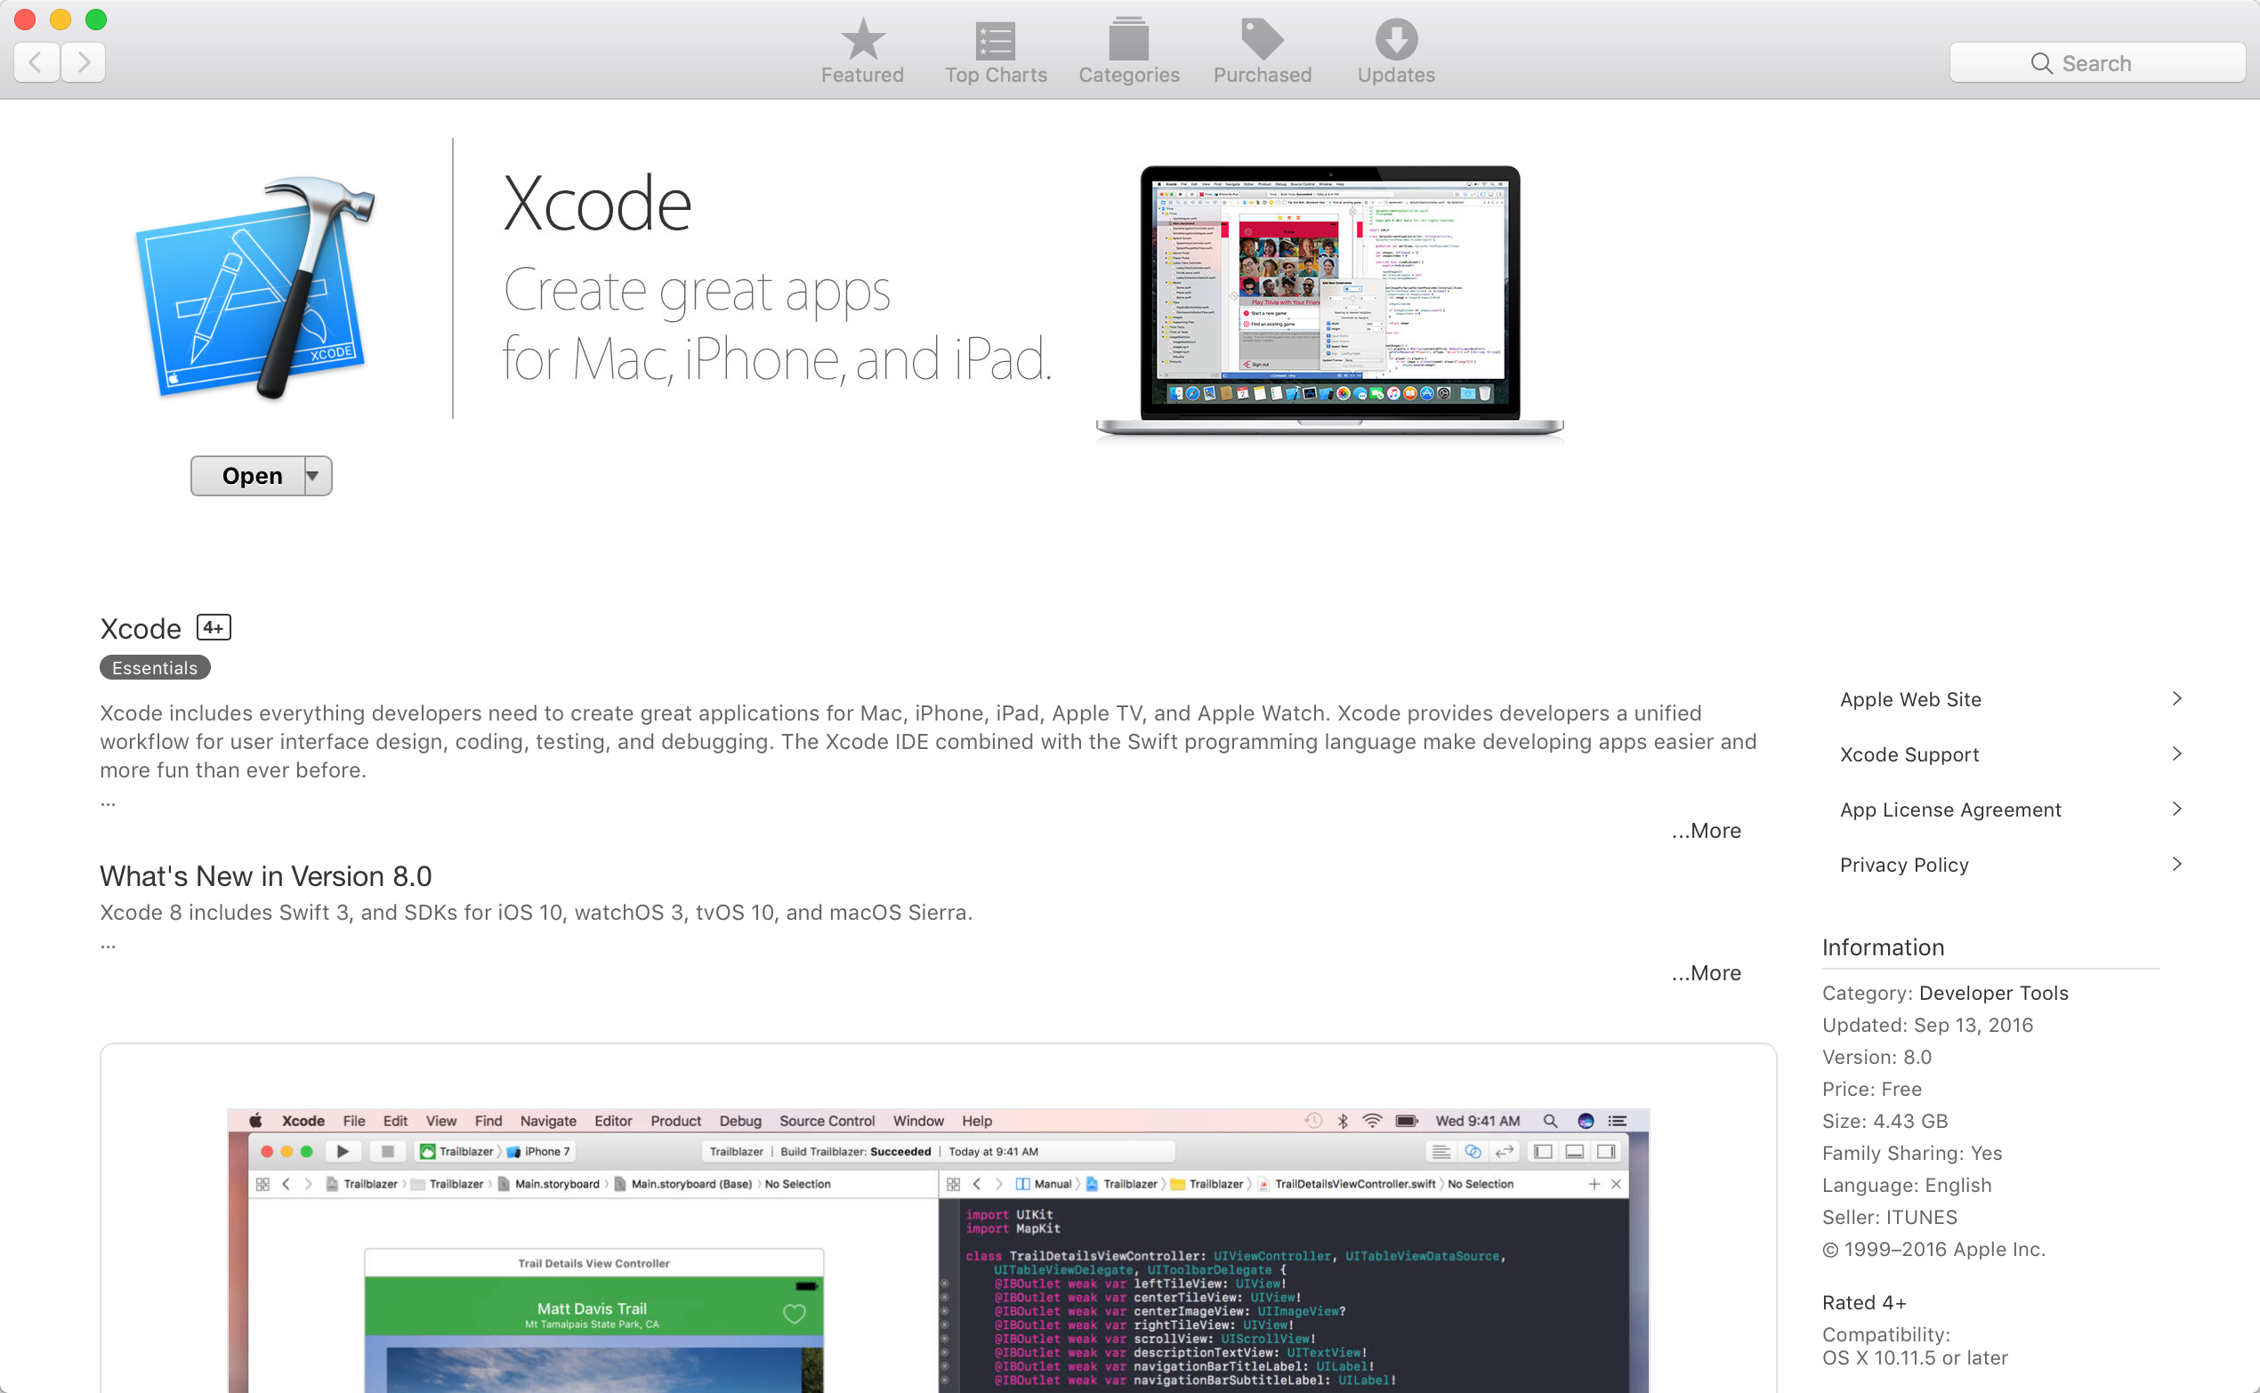
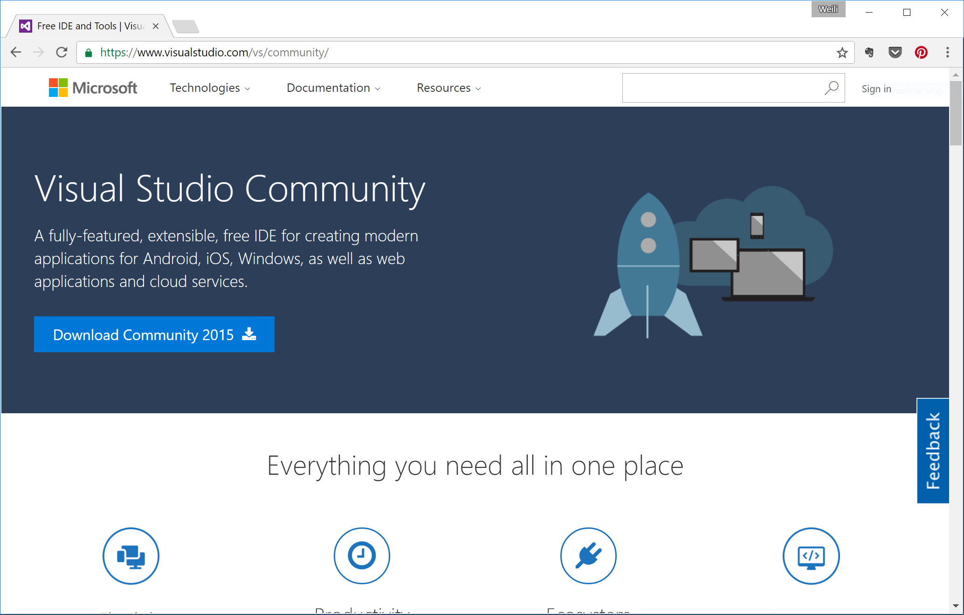
Mac
Install Xcode 8.0 via Mac App Store.
Windows
Download Visual Studio Community 2015 from https://www.visualstudio.com/vs/community/ and install it.
Notes:
Installing IDEs.

Slide 5
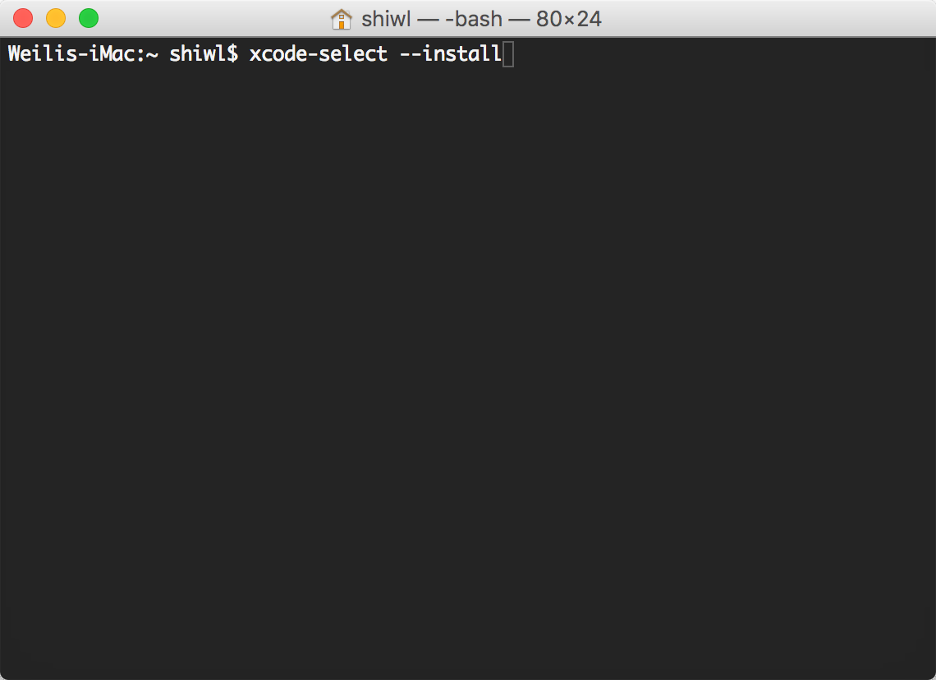
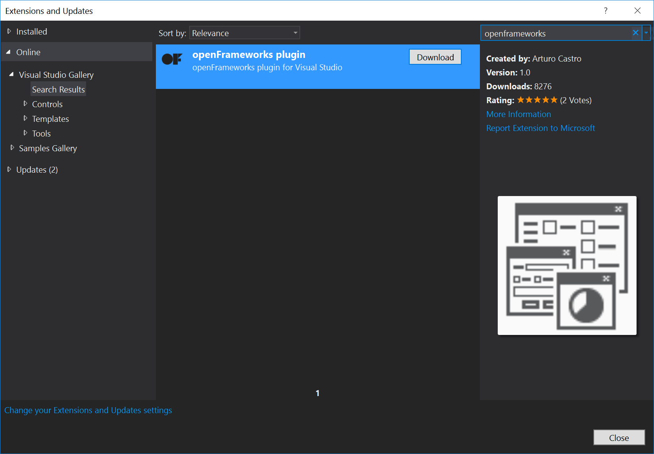
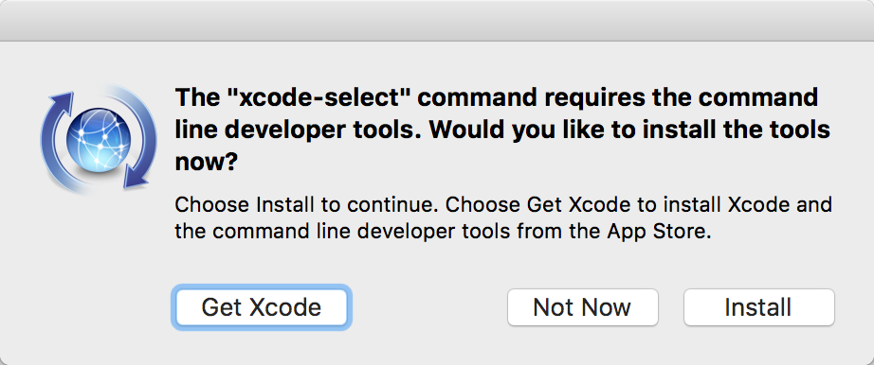
Mac
Install command line tools of Xcode using the following command in Terminal:
xcode-select --install
Windows
Download and install K-Lite Codec Pack - Version 12.1.0 Full April 18th 2016.
In Visual Studio, go to Tools > Extensions and Updates. Select online and search for openFrameworks and install the plugin.
Notes:
Configuring IDEs for oF.

Slide 6
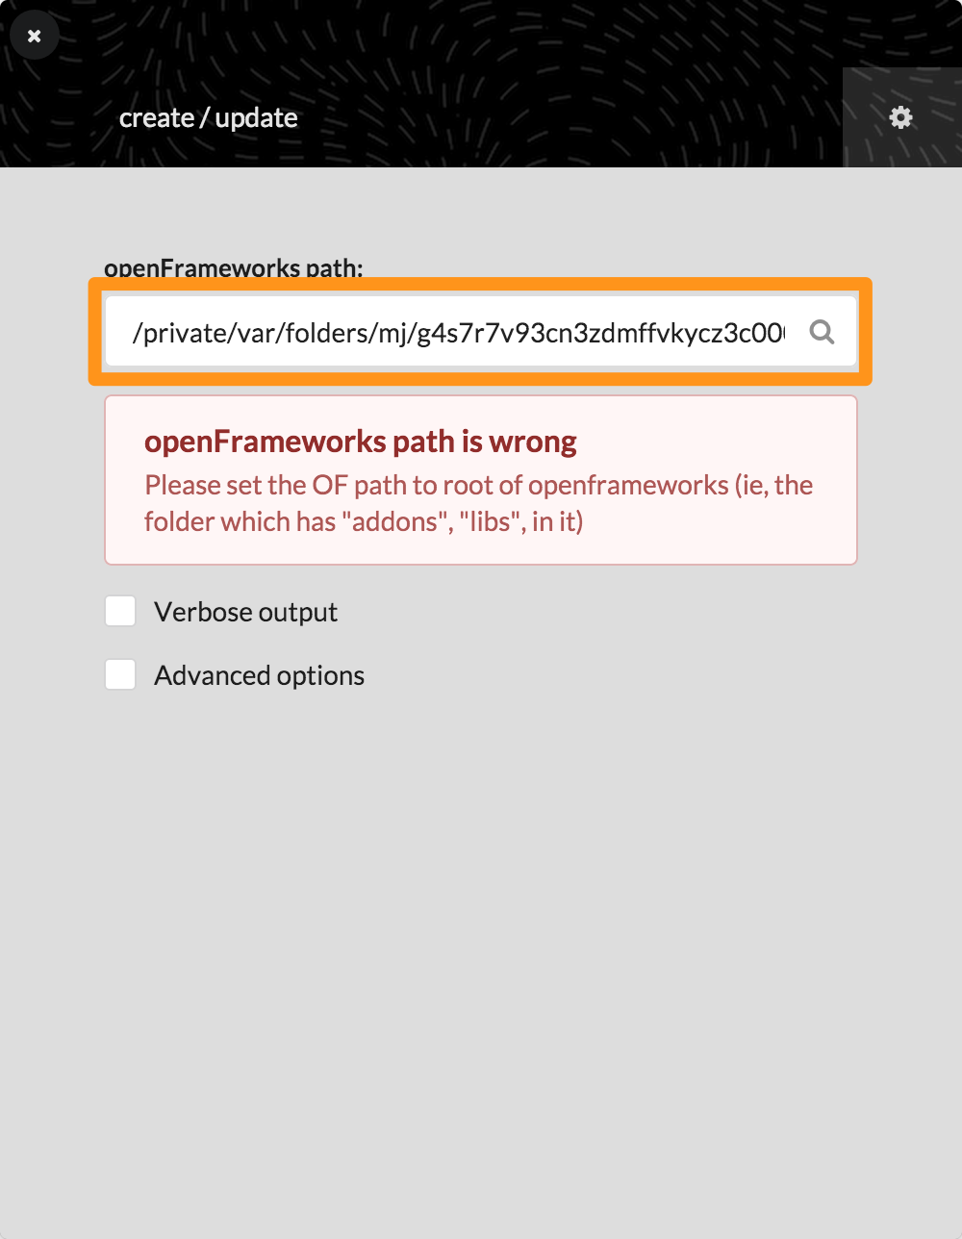
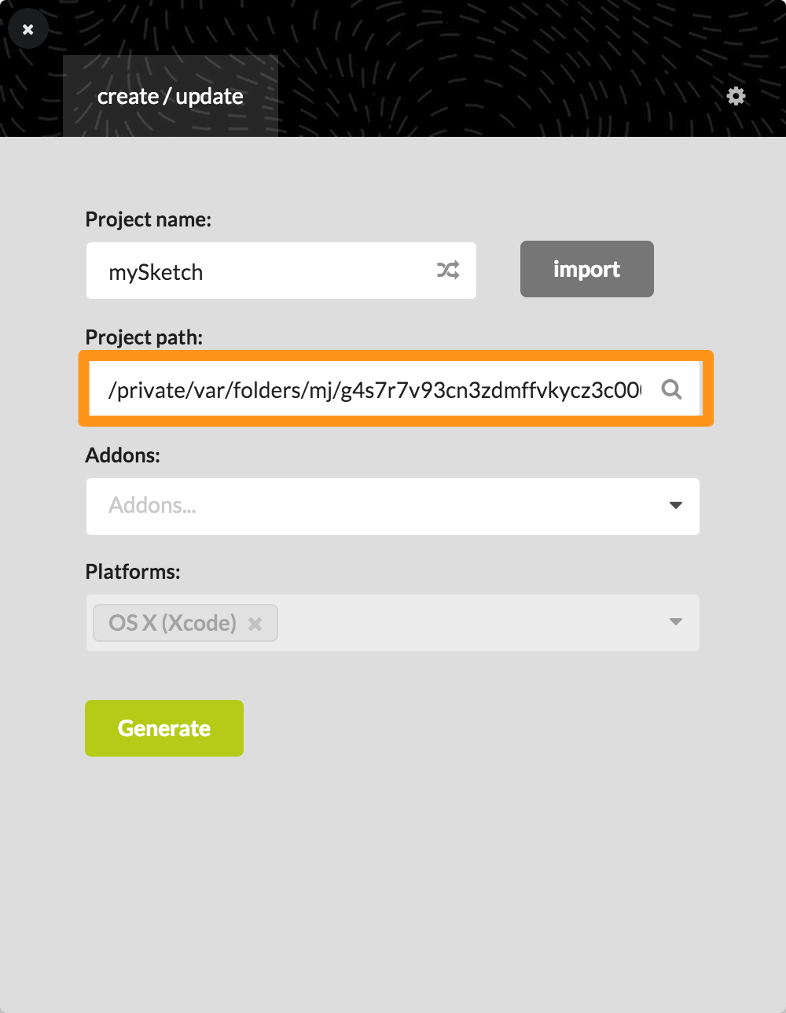
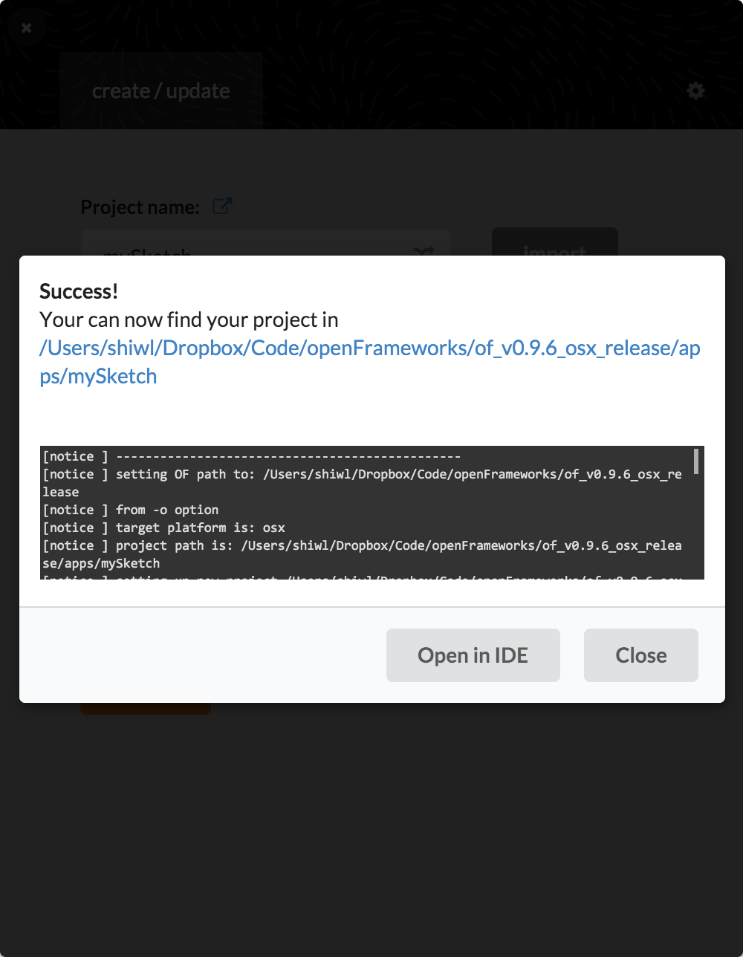
Use projectGenerator to create your first oF app!
Notes:
With oF 0.9.6/0.9.4 for Mac, you may need to set openFrameworks path to your oF root directory and project path to the apps directory every time.
You can change the name, path, and addons to include in your project.
Note the you can also import an existing project to add/remove addons.

Slide 7
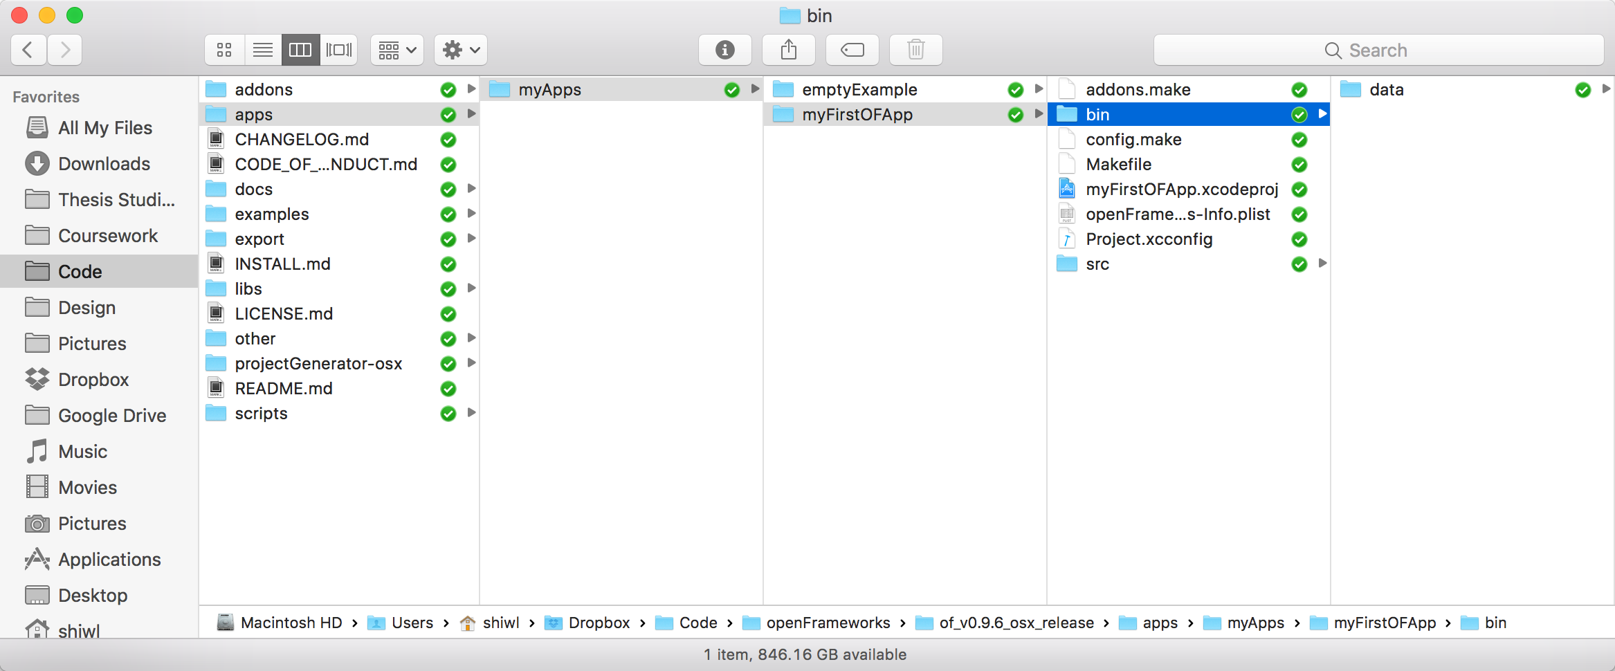
File structure of your oF app
Notes:
.xcodeproj file: your project file for Xcode. will be .sln if you use oF for Visual Studio.
src: your source code files.
bin: binary files. Currently no binaries here. You’ll see your oF app after you build it.
bin/data: runtime data for your oF app. If you want your app to read/write something from/to disk, this is where the file goes.

Slide 8
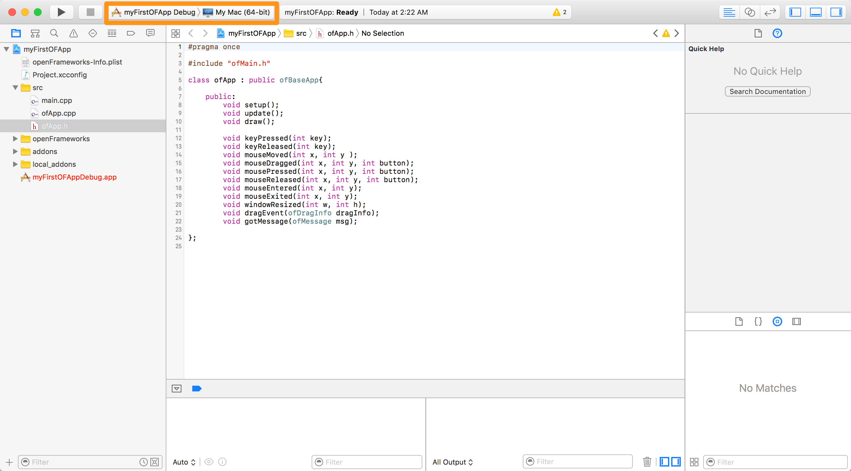
Build and run your first oF app!
Notes:
Getting familiar with your IDE:
Editor
This is where you write your code. Like processing main window.
Project Files Manager
This is where your project files will be. To be noticed that these are just a reference to your files (Especially in visual studio). If you add a new file in Finder/Explorer, they won’t show up in here.
Console/Debug Window
This is where the program will spit out things.
Before hitting the build and run button in Xcode, make sure you have selected the correct scheme (Debug or Release, not openFrameworks, which only builds oF itself, not your app)!
After a few minutes of work (this will be much faster the from the next time on), Xcode will run your first oF app—a grey window, very exciting. ; )

Slide 9
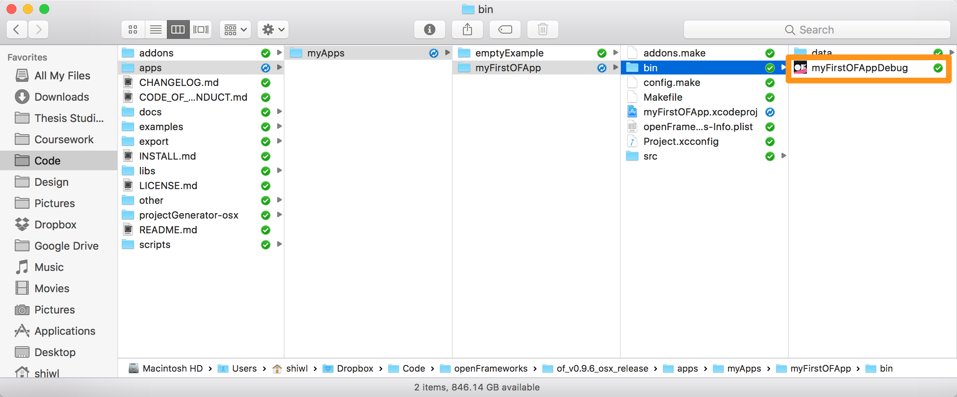
What has happened when you clicked the build button?
Notes:
In bin directory, a new binary file appeared. Double click it will bring you the same grey window—this is your oF app.
What does building mean?
Everything in a computer is represented by a series of 1's and 0’s (called machine language). When the computer runs a program, the program itself is made of a bunch of 1's and 0's. However, since we still need humans to write our programs, putting everything in 1's and 0's would be very difficult. So we made higher level languages like C++ to write code in. These languages look a lot more like English, so they're a lot easier to write and maintain. When you compile code, the compiler (usually another program) takes the program the human wrote, and converts it into the program the computer can understand (i.e. machine language).

Slide 10
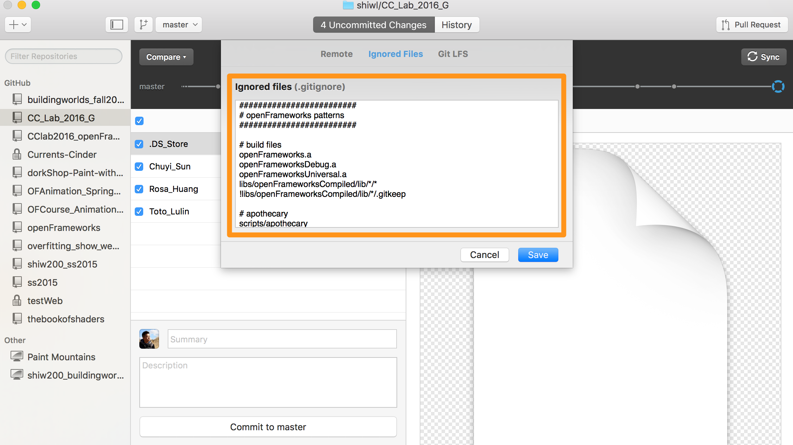
Use .gitignore to avoid tracking unneeded files with git
Notes:
As you compile your openFrameworks project, there's a lot of files that don't need be track and uploaded to Github, for example your executables( .app or .exe). So we need to tell Git to ignore all this unnecessary files.

Slide 11
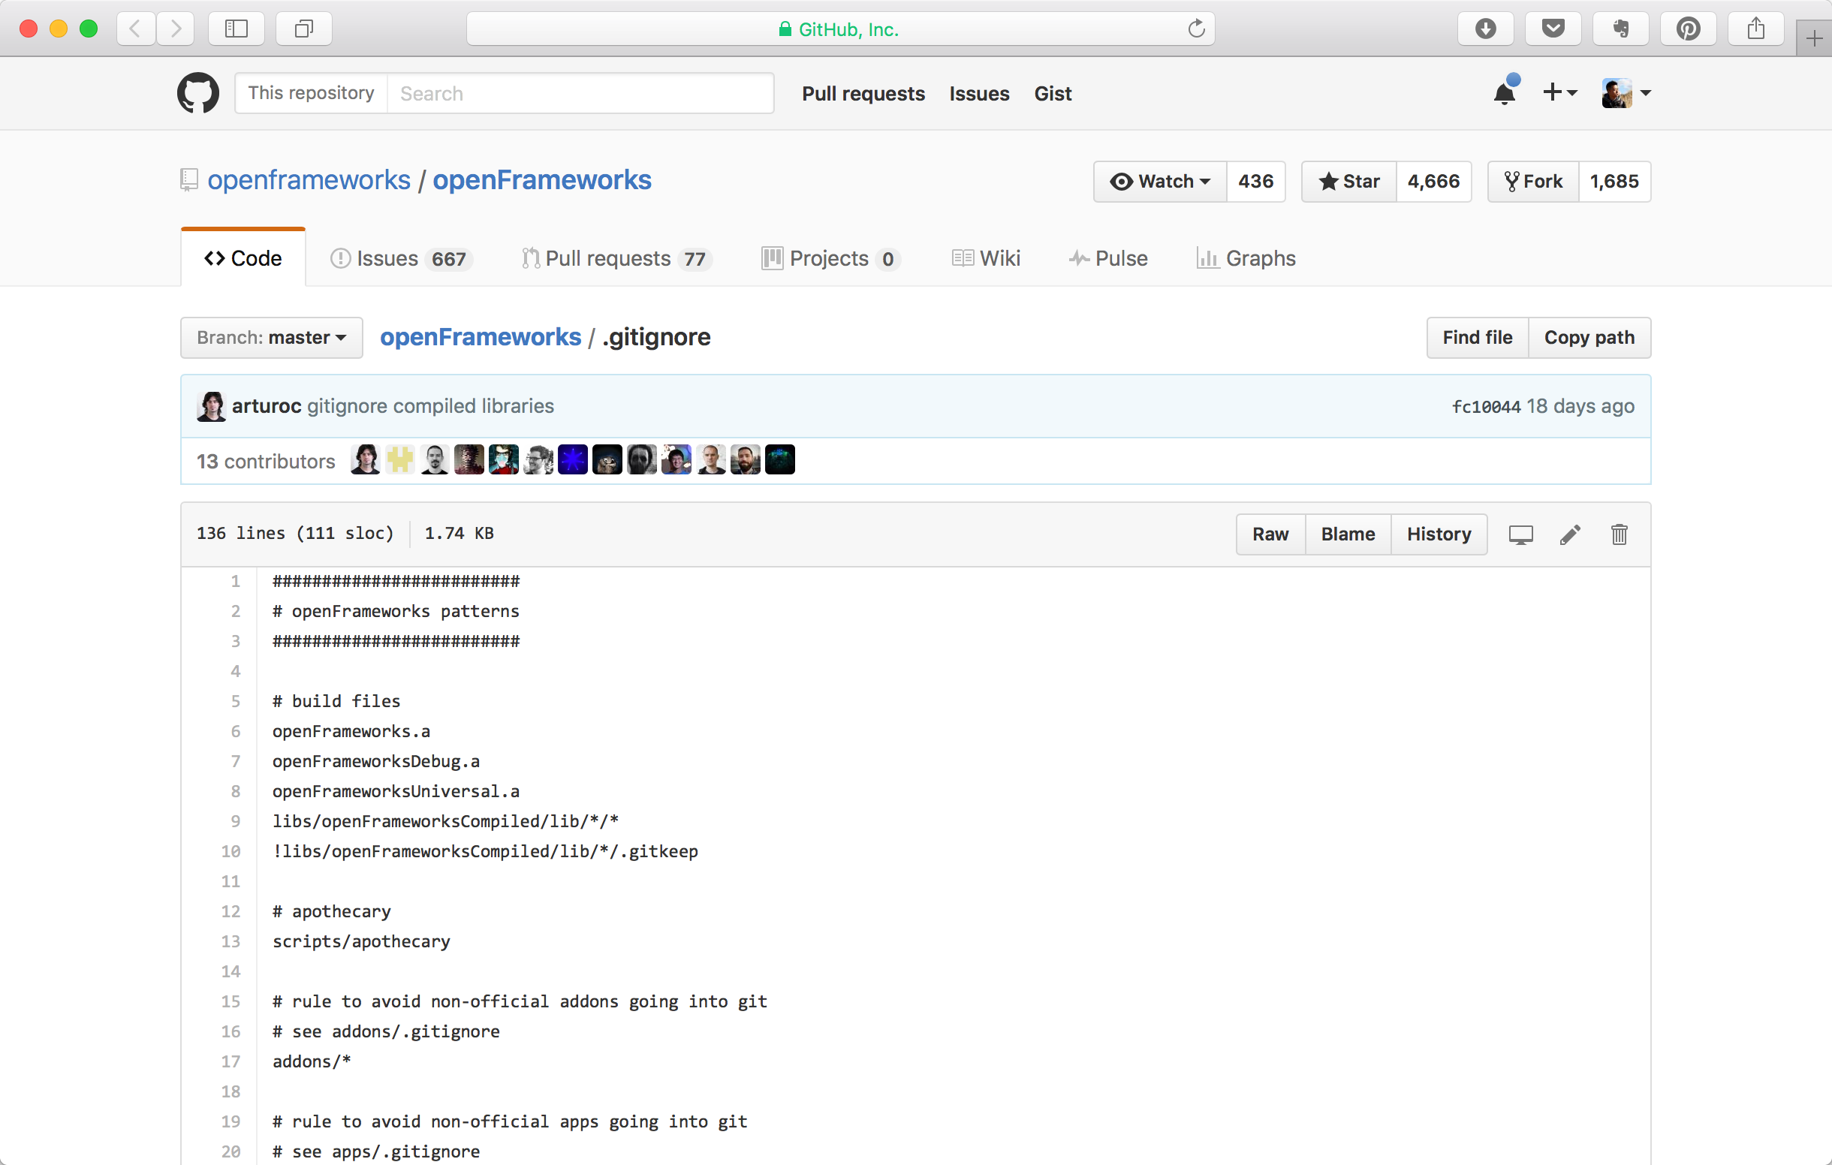
The easiest way to get related .gitignore file is from oF github repo at https://github.com/openframeworks/openFrameworks/blob/master/.gitignore
Notes:
Create your own .gitignore and then copy those lines in there. Be should to put this file in your project root folder!
If you are using GitHub Desktop, you can also copy and paste the ignore list to the “Ignored Files” tab of the “Repository Settings…” dialog box.

Slide 12
Let’s add some code to your oF app to make it more interesting!
STEP 0: draw static circle
STEP 1: declaring variables and constants
STEP 2: initialize variables
STEP 3: apply a force to the circle when mouse pressed
STEP 4: update physics in every frame
STEP 5: draw updated circle in every frame
STEP 6: bring back our circle when it is off stage

Slide 13
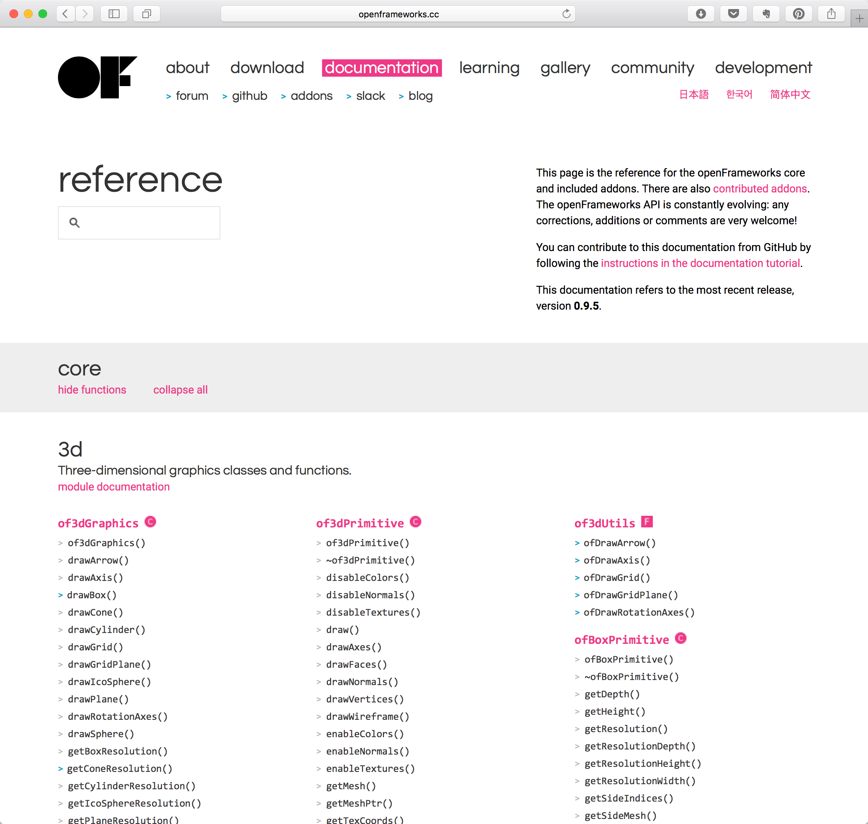
Always go to http://openframeworks.cc/documentation/ for reference!

Slide 14
Hmm, vector math…
Notes:
a - b results in a vector pointing from b to a.
Therefore, mAcceleration = mPos - mousePos means mAcceleration points from mousePos to mPos.

Slide 15
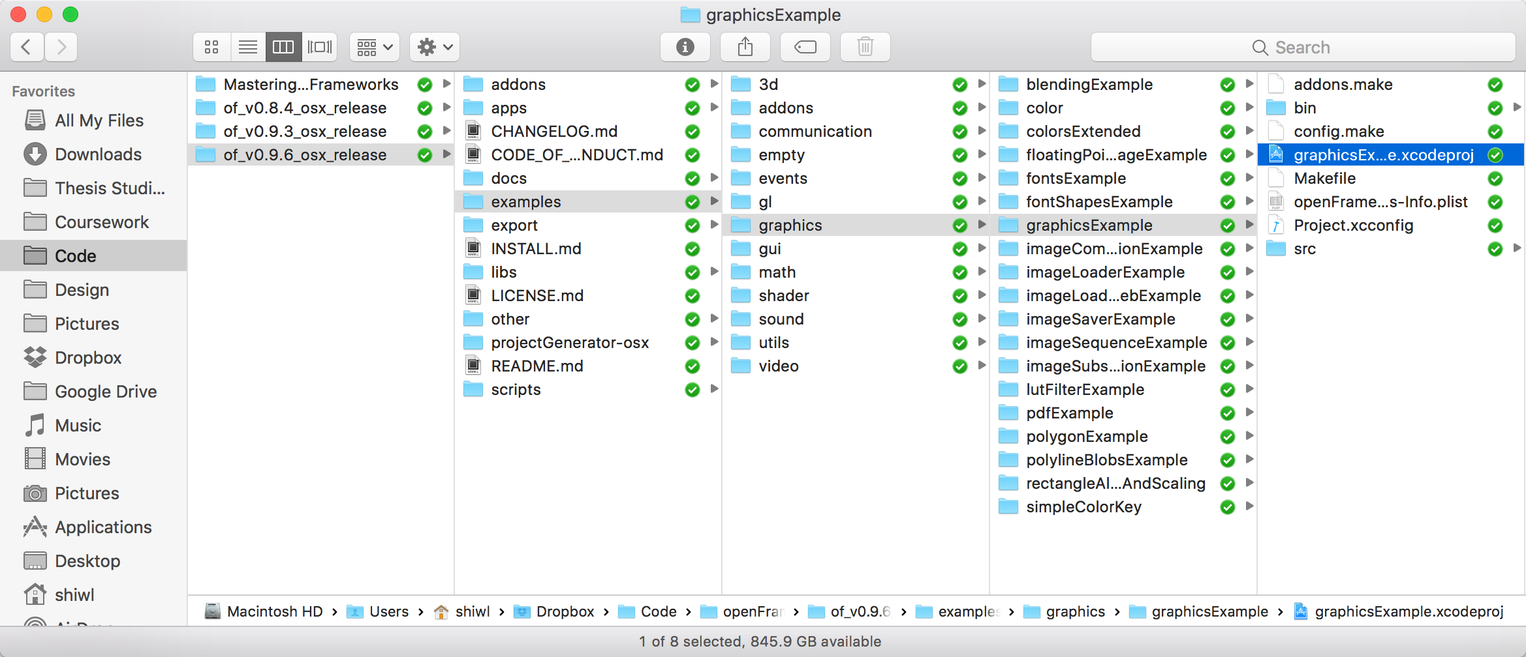
Explore the examples
Notes:
Use the graphics example to explain a bit more about drawing different things.
If there is more time, introduce additional examples.

Slide 16
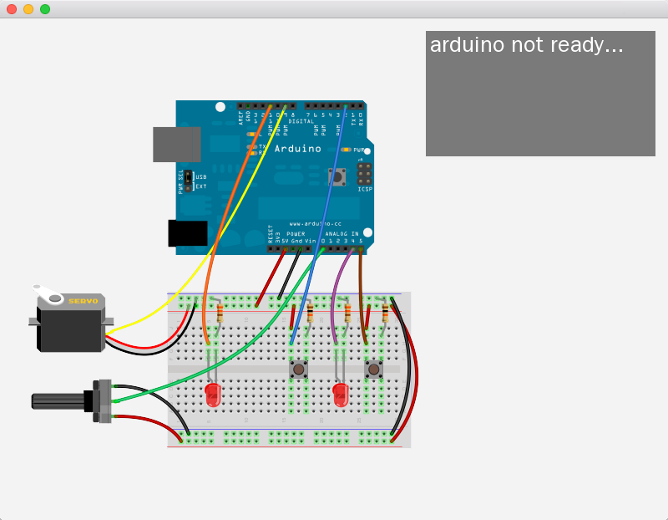
Bonus: firmataExample!
Notes:
Using Firmata just as easy as using it inside processing. Connect your stuff following the schematics. Load the standardFirmata project onto your Arduino. Open openFrameworks example under examples\communication\firmataExample\ . Check the code and change the port to your Arduino port (important).
Then learn from the example, and use Firmata with oF in your own projects.

Slide 17
Homework
Creating your simple openFrameworks program, it should be
Interactive (mouse click, key press, physical button, etc.)
Use 8 or more different openFrameworks functionalities (oF***)
Draw graphics
Print out stuff either on screen or in console
Push your code to Github, publish a video demo to our slack channel.

